Slide 1
PROJECT PRESENTATION HOUSING PROJECT
Notes:
This template can be used as a starter file to give updates for project milestones.
Sections
Right-click on a slide to add sections. Sections can help to organize your slides or facilitate collaboration between multiple authors.
Notes
Use the Notes section for delivery notes or to provide additional details for the audience. View these notes in Presentation View during your presentation.
Keep in mind the font size (important for accessibility, visibility, videotaping, and online production)
Coordinated colors
Pay particular attention to the graphs, charts, and text boxes.
Consider that attendees will print in black and white or grayscale. Run a test print to make sure your colors work when printed in pure black and white and grayscale.
Graphics, tables, and graphs
Keep it simple: If possible, use consistent, non-distracting styles and colors.
Label all graphs and tables.

Slide 2
Project Overview
What is the project about?
Define the goal of this project
Data Collection
Notes:
What is the project about?
Define the goal of this project
Is it similar to projects in the past or is it a new effort?
Define the scope of this project
Is it an independent project or is it related to other projects?
* Note that this slide is not necessary for weekly status meetings

Slide 3
What is the project about?
Houses are one of the necessary need of each and every person around the globe and therefore housing and real estate market is one of the markets which is one of the major contributors in the world’s economy. It is a very large market and there are various companies working in the domain. Data science comes as a very important tool to solve problems in the domain to help the companies increase their overall revenue, profits, improving their marketing strategies and focusing on changing trends in house sales and purchases. Predictive modelling, Market mix modelling, recommendation systems are some of the machine learning techniques used for achieving the business goals for housing companies. Our problem is related to one such housing company. A US-based housing company named Surprise Housing has decided to enter the Australian market. The company uses data analytics to purchase houses at a price below their actual values and flip them at a higher price. For the same purpose, the company has collected a data set from the sale of houses in Australia. The data is provided in the CSV file below. The company is looking at prospective properties to buy houses to enter the market. We are required to build a model using Machine Learning in order to predict the actual value of the prospective properties and decide whether to invest in them or not. For this company wants to know: • Which variables are important to predict the price of variable? • How do these variables describe the price of the house?

Slide 4
GOAL
We are required to model the price of houses with the available independent variables. This model will then be used by the management to understand how exactly the prices vary with the variables. They can accordingly manipulate the strategy of the firm and concentrate on areas that will yield high returns. Further, the model will be a good way for the management to understand the pricing dynamics of a new market.

Slide 5
DATA COLLECTION
The company has collected a data set from the sale of houses in Australia.
Data contains 1460 entries each having 81 variables.
There is separate training and testing datasets

Slide 6
Check the Names of the Columns
Numerical columns:-
'Id', 'MSSubClass', 'LotFrontage', 'LotArea', 'OverallQual', 'OverallCond', 'YearBuilt', 'YearRemodAdd', 'MasVnrArea', 'BsmtFinSF1', 'BsmtFinSF2', 'BsmtUnfSF', 'TotalBsmtSF', '1stFlrSF', '2ndFlrSF', 'LowQualFinSF', 'GrLivArea', 'BsmtFullBath', 'BsmtHalfBath', 'FullBath', 'HalfBath', 'BedroomAbvGr', 'KitchenAbvGr', 'TotRmsAbvGrd', 'Fireplaces', 'GarageYrBlt', 'GarageCars', 'GarageArea', 'WoodDeckSF', 'OpenPorchSF', 'EnclosedPorch', '3SsnPorch', 'ScreenPorch', 'PoolArea', 'MiscVal', 'MoSold', 'YrSold', 'SalePrice', 'LogSalePrice‘-
Categorical columns:-
'MSZoning', 'Street', 'LotShape', 'LandContour', 'Utilities', 'LotConfig', 'LandSlope', 'Neighborhood', 'Condition1', 'Condition2', 'BldgType', 'HouseStyle', 'RoofStyle', 'RoofMatl', 'Exterior1st', 'Exterior2nd', 'MasVnrType', 'ExterQual', 'ExterCond', 'Foundation', 'BsmtQual', 'BsmtCond', 'BsmtExposure', 'BsmtFinType1', 'BsmtFinType2', 'Heating', 'HeatingQC', 'CentralAir', 'Electrical', 'KitchenQual', 'Functional', 'FireplaceQu', 'GarageType', 'GarageFinish', 'GarageQual', 'GarageCond', 'PavedDrive', 'SaleType', 'SaleCondition'
Notes:
* If any of these issues caused a schedule delay or need to be discussed further, include details in next slide.

Slide 7
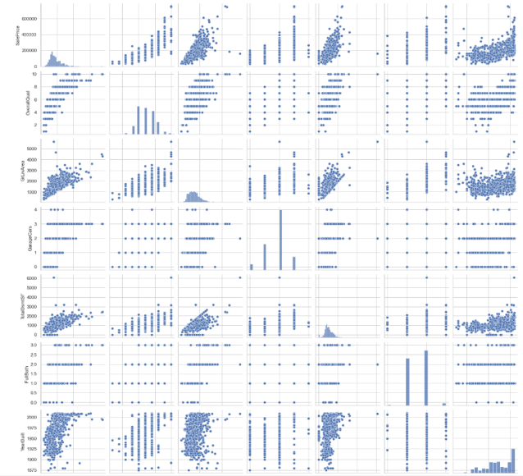
Visualization of the Data- Pairplot
Notes:
We see similar kinds of data but we are not able to make out any difference or any trend , we see the data is all right skewed

Slide 8
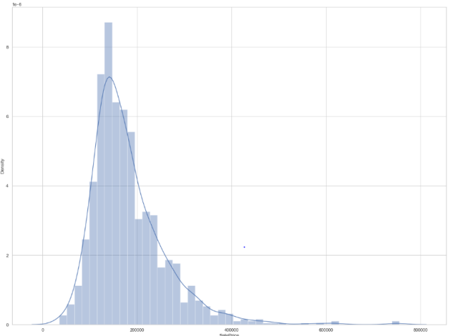
Plotting the label-SalePrice
Notes:
Same here we are not able to see the trend properly , need to analyze them individually

Slide 9
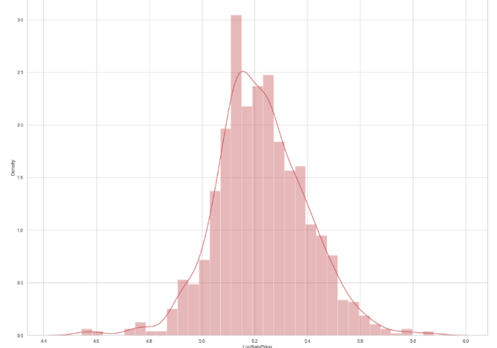
Treating the column with log transformation to make it more normal distribution
Notes:
Same here we are not able to see the trend properly , need to analyze them individually

Slide 10
Checking for null values
As per the output we see many nulls , We are treating them by:-
Replacing the nan values with mean for LotFrontage
Removing the features-Alley,PoolQC,Fence,MiscFeature as they had 80% or more null values which cannot be replaced
Replacing the columns- BsmtQual,BsmtQual,BsmtCond,BsmtExposure,BsmtFinType1,BsmtFinType2’s null values with NA as a new class.
Replacing missing values for MasVnrType with None
Replacing missing values for MasVnrArea with median
Replacing the columns- GarageType,GarageFinish,GarageQual,GarageCond ‘s null values with NA as a new class.
Handling the missing value for GarageYrBlt with median
Handling the missing value for Electrical with new class
Handling the missing values for FireplaceQu with NA as a new class

Slide 11
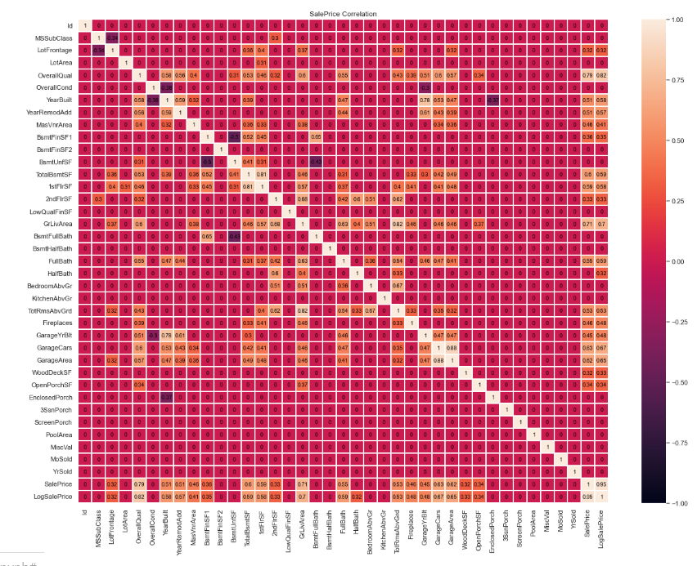
Correlation

Slide 12
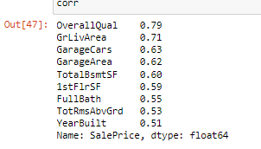
Top 10 more correlated with Target

Slide 13
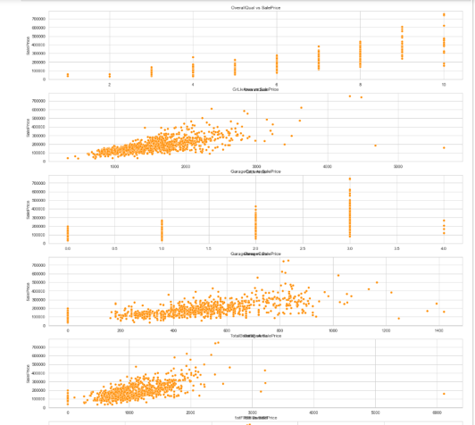
Graphs to show relationship with target of top features

Slide 14
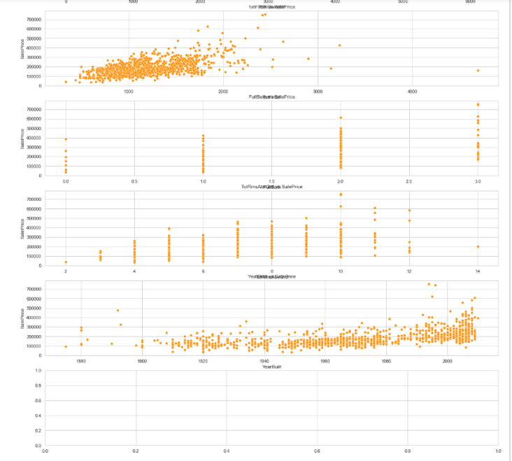

Slide 15
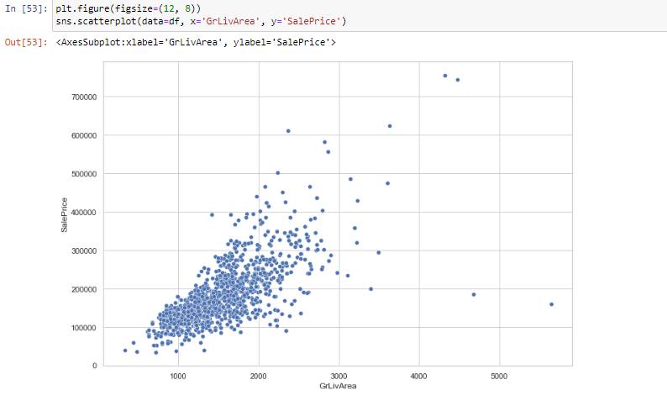
Visualization - EDA

Slide 16
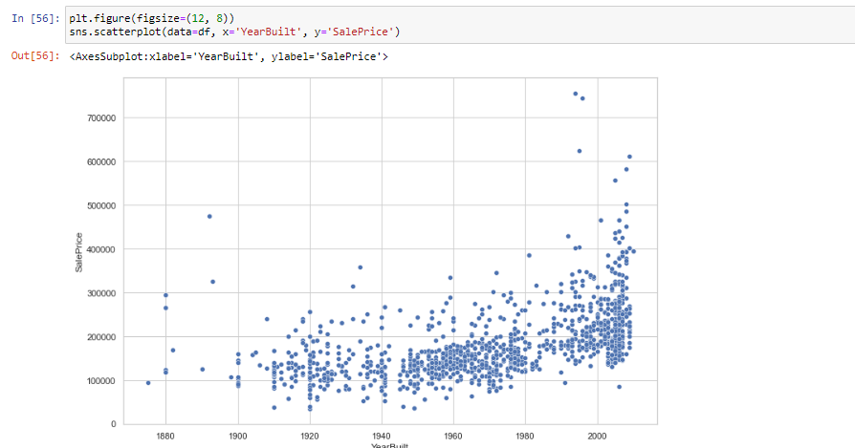

Slide 17
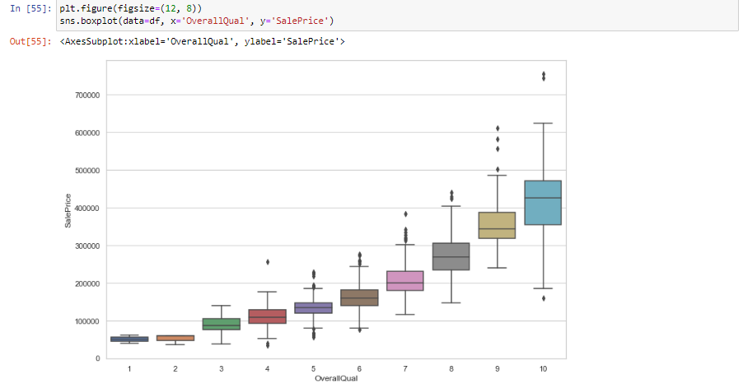

Slide 18
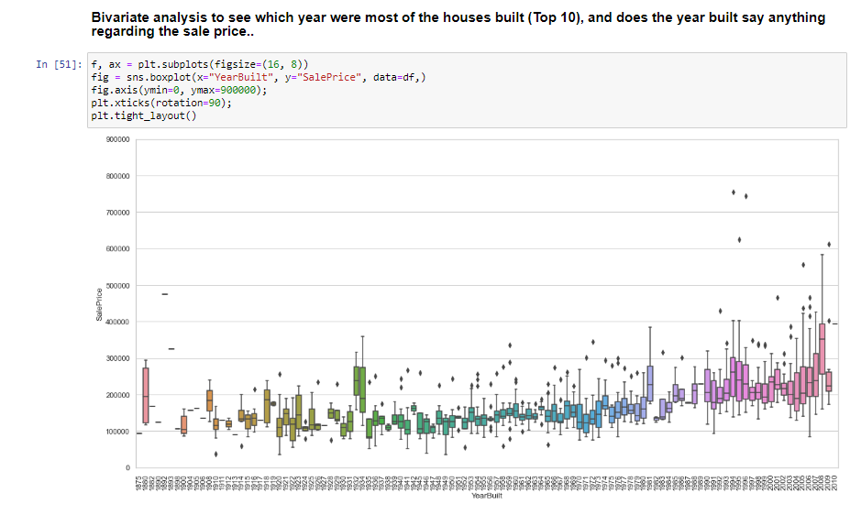

Slide 19
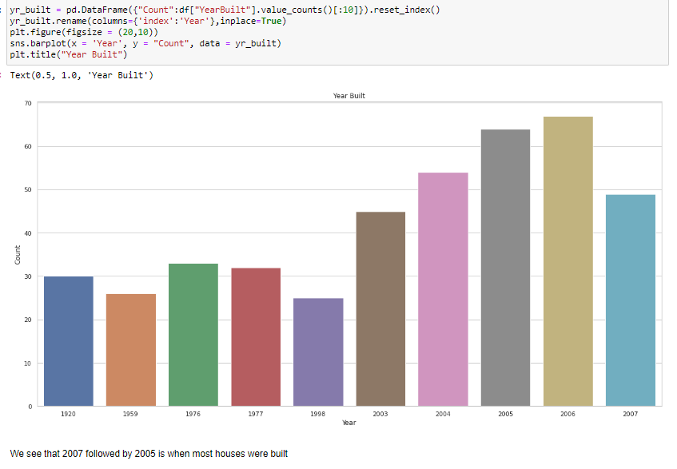

Slide 20
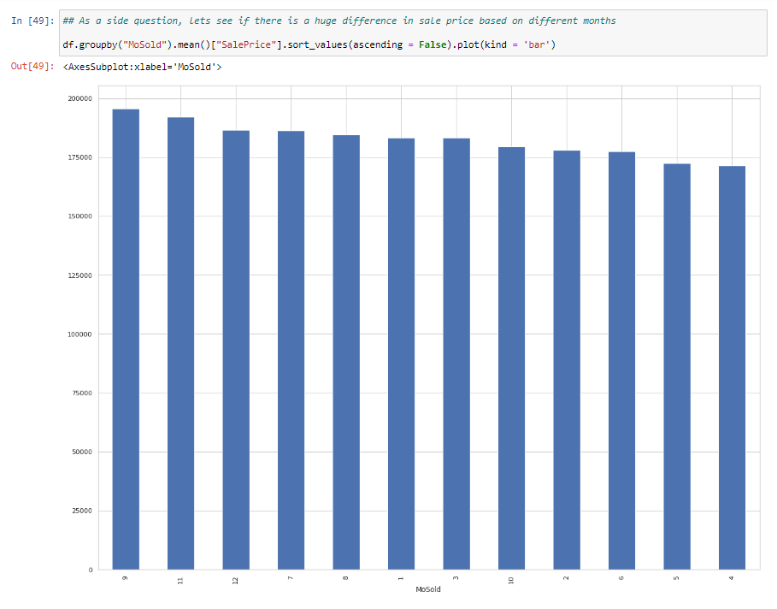

Slide 21
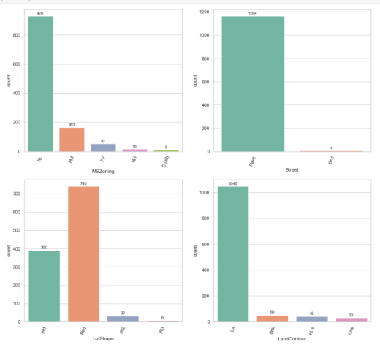
Visualization of categorical features

Slide 22
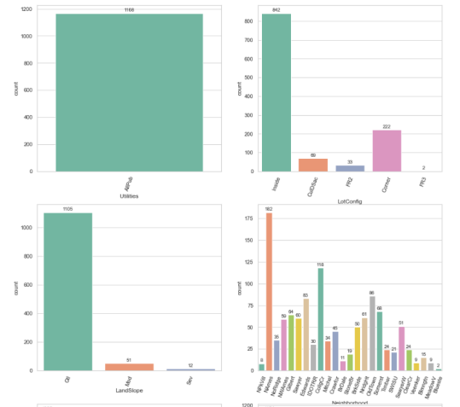

Slide 23
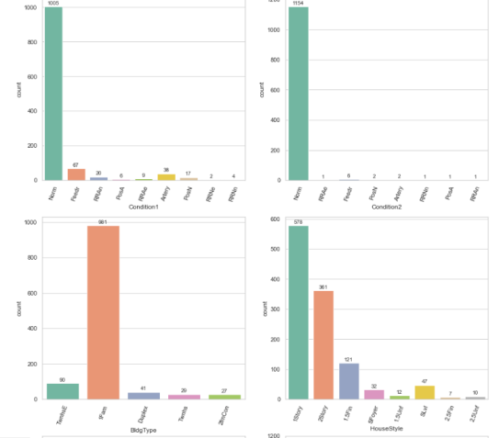

Slide 24
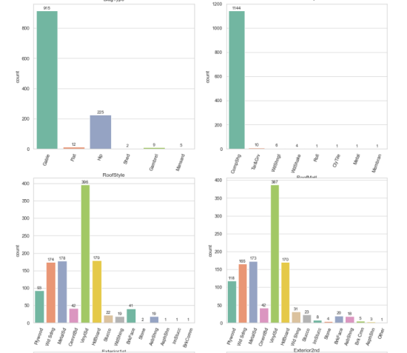

Slide 25
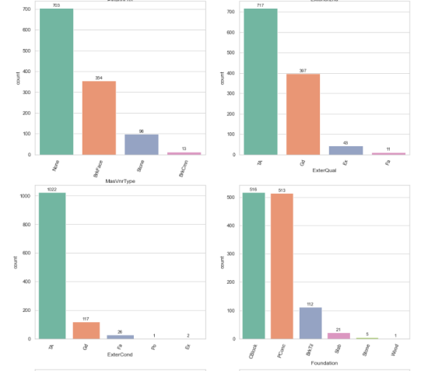

Slide 26
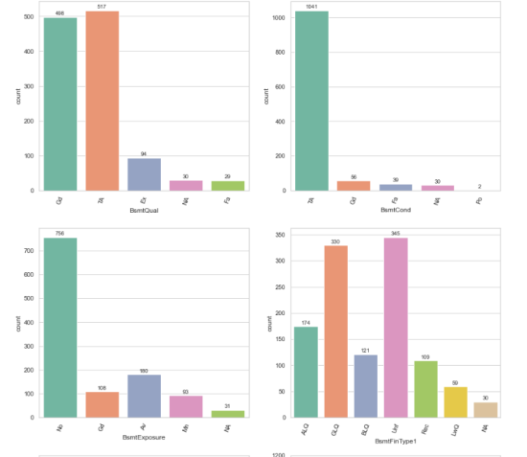

Slide 27
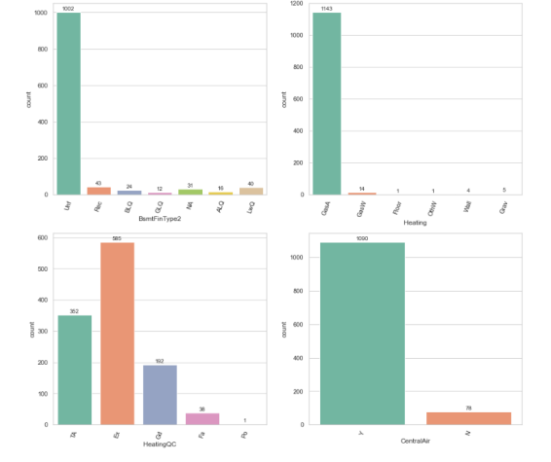

Slide 28
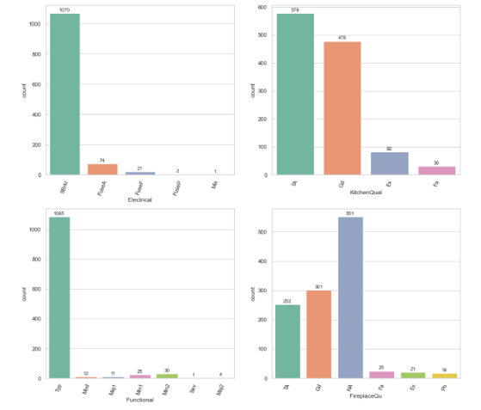

Slide 29
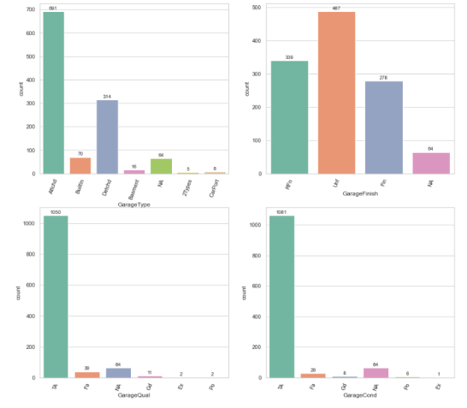

Slide 30
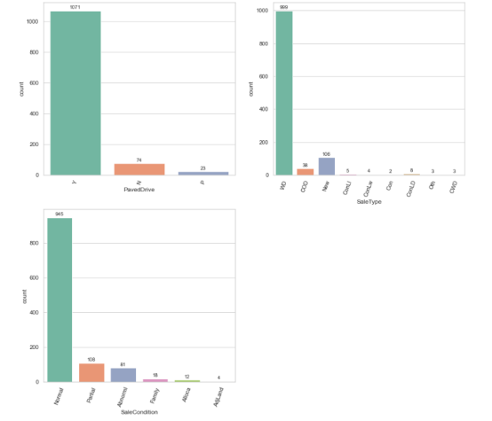

Slide 31
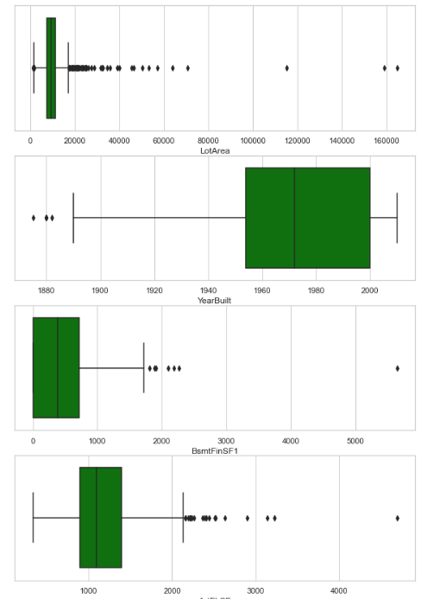
Finding the outliers

Slide 32
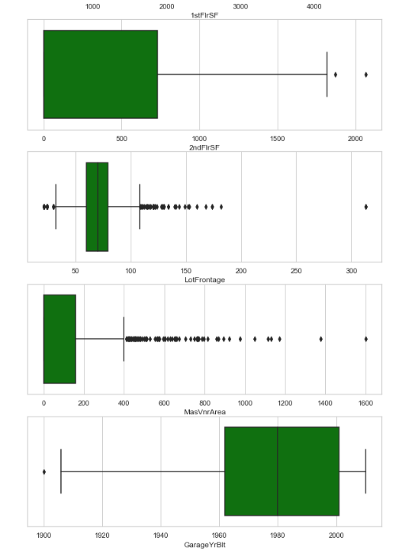

Slide 33
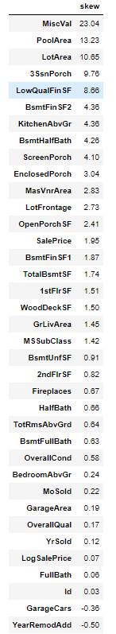
CHECKING THE SKEWNESS

Slide 34
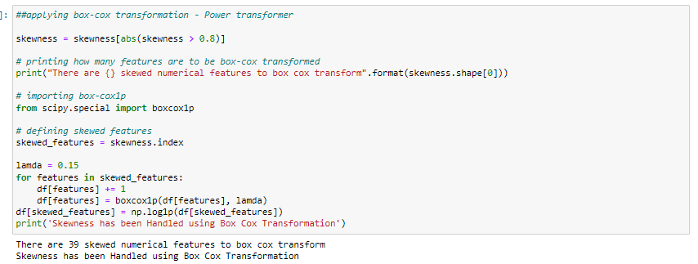
Treating skewness with Power transformer

Slide 35
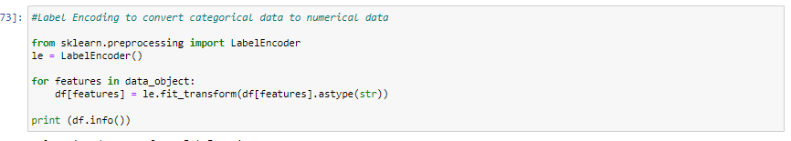
Encoding the categorical columns

Slide 36
Imported Test data
Followed similar steps to remove nulls
Created a new columns called SalePrice with blank values
Split into X and y for features and target

Slide 37
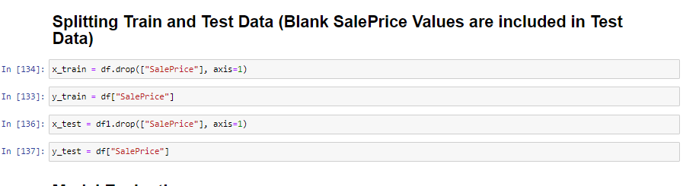
Splitting training and testing

Slide 38
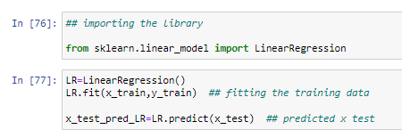
Model Evaluation
Linear Regression

Slide 39
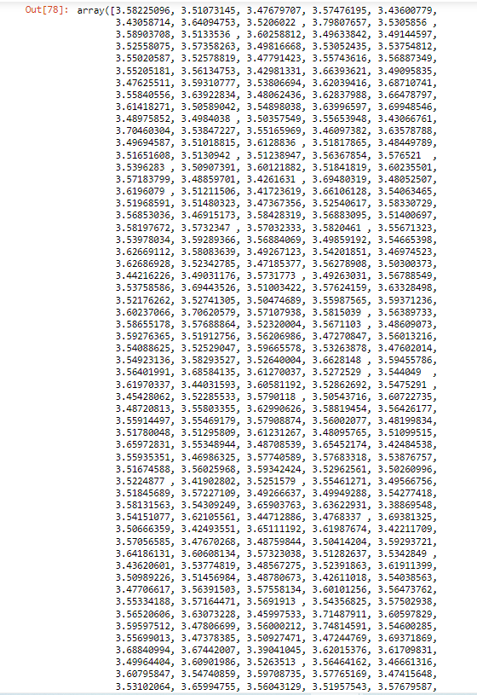
Predicted points

Slide 40
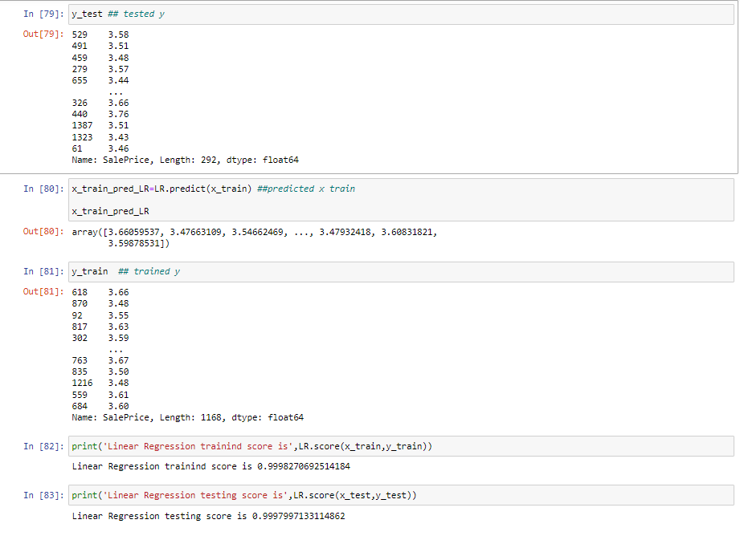

Slide 41
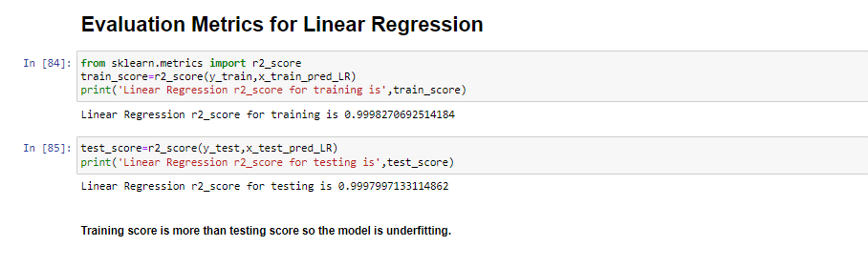
Metrics

Slide 42
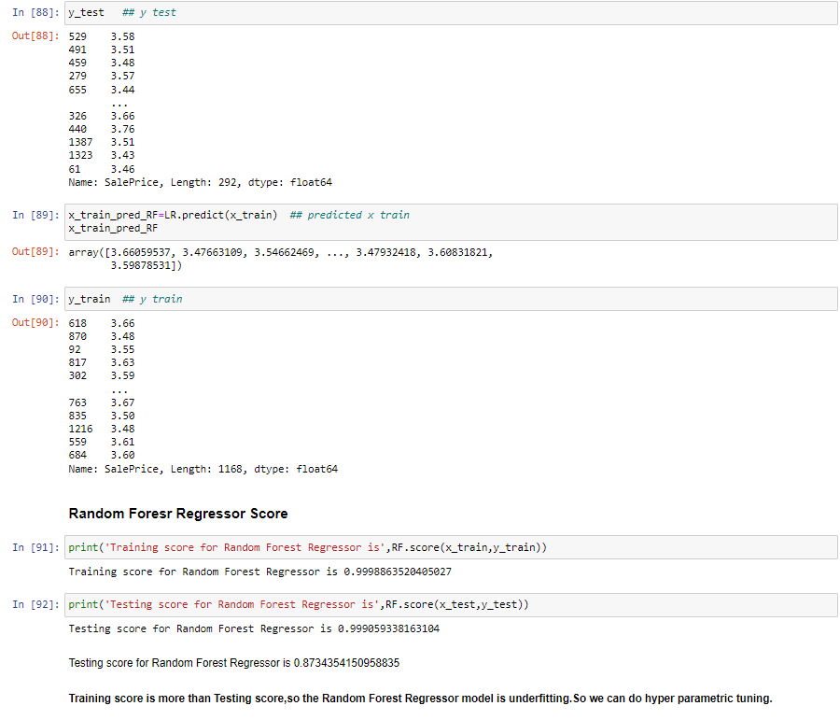
Random forest Regressor

Slide 43
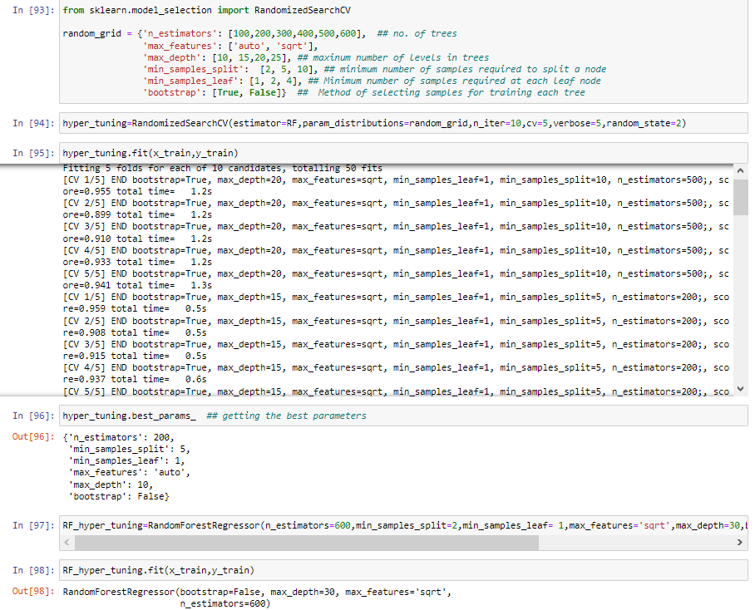
Hyperparameter tuning

Slide 44
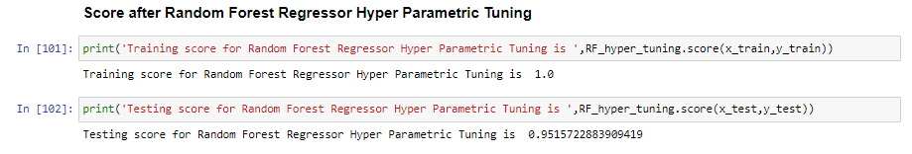

Slide 45
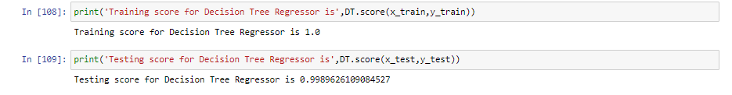
Decision Tree Regressor
Without tuning score:

Slide 46
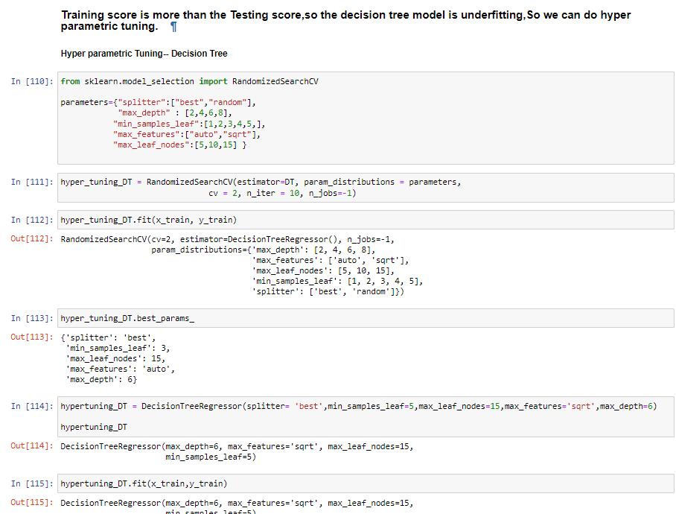

Slide 47
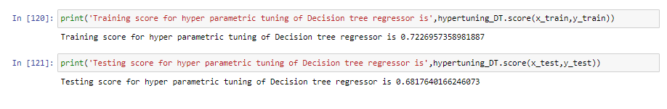
After Hyperparameter tuning

Slide 48
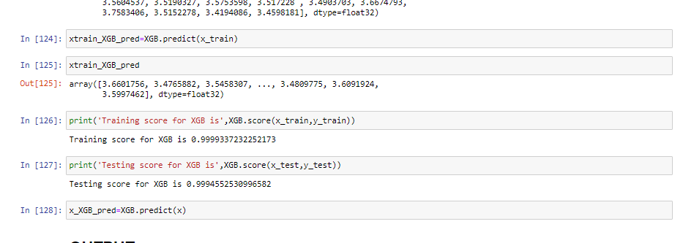
XG Boost Regressor

Slide 49
Conclusion
XGoost Regressor gave the best score
Training score for XGB is 0.9999337232252173
Testing score for XGB is 0.9994552530996582
The train is higher than test which random forest didn’t have so we will use this model

